Slide 1
PYTHON MINI PROJECT (Pong Game)
By Khan Mujahid Nasir (19)
Vinayak. G. Chavan (08)
Bharat .C. Dave (10)

Slide 2
Introduction:-
Ping-Pong is a trademark name for table tennis and associated equipment. The name “Ping-Pong” was invented by the English firm J. Jaques and Son at the end of the 1800’s and later trademarked in the United States by Parker Brothers, the board game company.

Slide 3
Continued….
Today the pong game is digitalized in our systems as a game of interest played by millions of player world while. The pong game has been converted in 2-D and 3-D formats as well as played on the VR’s and T.V. video games with remotes.

Slide 4
Requirements:-
Hardware Requirements:
Any laptop ,PC will do for the program to run
Windows OS, 2 GB Ram, 500 MB ROM.
Software Requirements:
1. Python Software version 3.7 (32 bit)
2.Pygame Installed in Python

Slide 5
ALGORITHM:-
1. Import Pygame, colours , ball , racket , directions ,player
2. Create clock using Pygame.
3. Set screen size and fps.
4. Get directions for left and right player and racket.
5. Get position for ball.
6. Set a game over screen when a player reaches max score.
7. Until not a game over screen do:
A . Fill screen, draw ball racket, scoreboard and fill them too.
B. Set keyboard keys to map to the racket movements.
C. Update score at every point until no one wins.
8.End

Slide 6
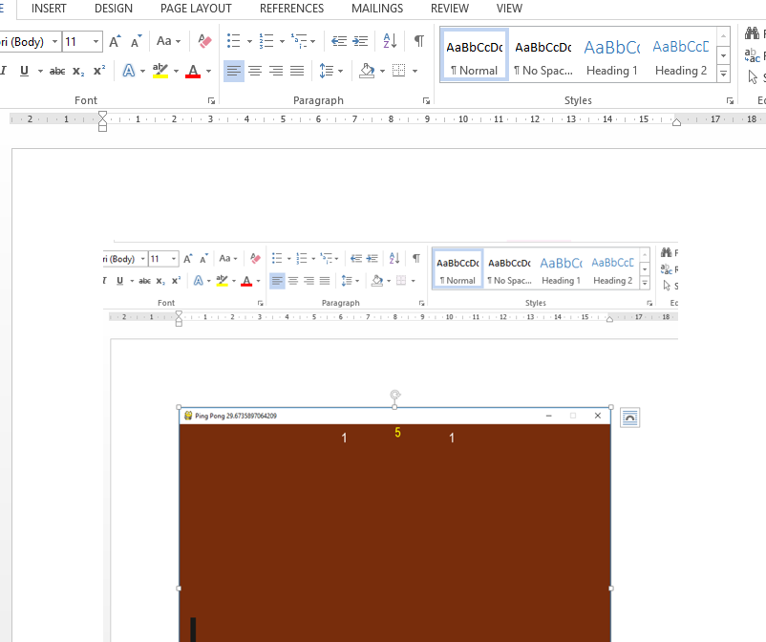
Output:

Slide 7
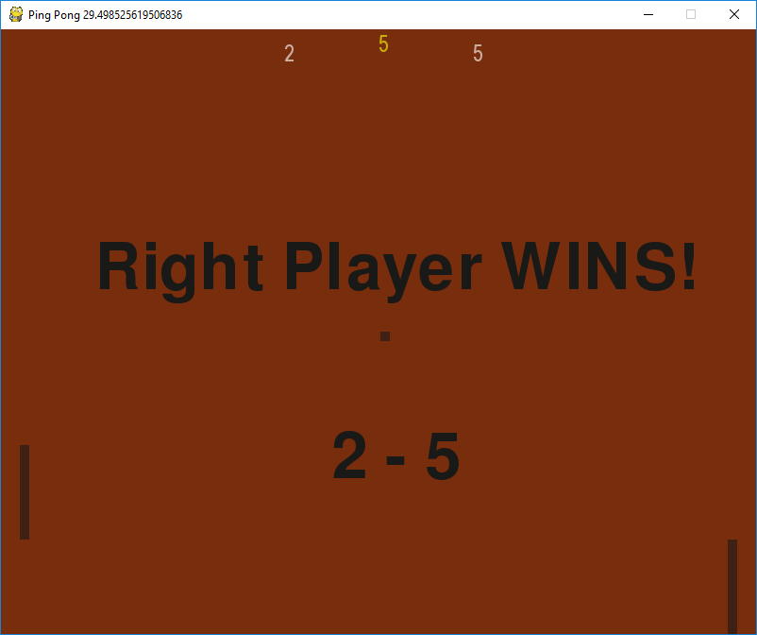
Output:

